Slide 1

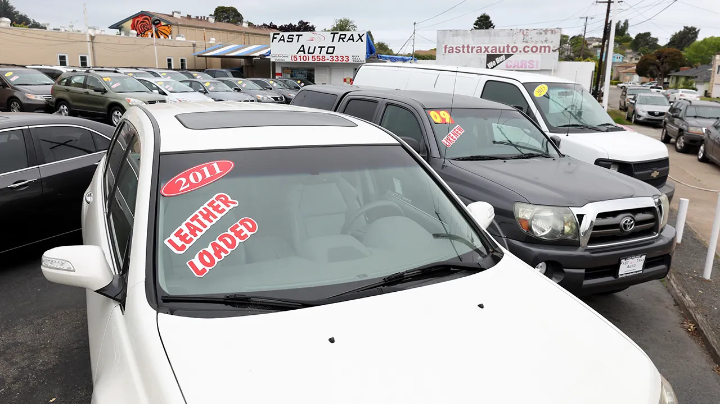
DNN-Based Car Price Prediction From Used Cars

Slide 2




Team 03:
Shrey Kevadia Anthony Mingus Fernando Malca William Widjaja

Slide 3
The Issue
Fraudulent Pricing Practices:
Unseen Fees, add-ons, inflated service charges, etc. (bait-and-switch)
Leader Automotive Group (Illinois, 2024)
Vehicle History Concealment
Dealerships concealing/misrepresenting a car’s history (odometer tampering, undisclosed accidents, etc.)
Speaker: Fernando Malca

Slide 4
The Hypothetical Solution:
We would train a neural network model in hopes of offering:
Fair-Market Price Prediction
Consumers are able to view the fair-market price of a car from the previous used car sales
Anomaly Flagging
Listings that exceed the final price of the predicted price of a car can be flagged for review
Zero-Burden Transparency
Lowering time, complexity, and paperwork
Speaker: Fernando Malca

Slide 5

Dataset Used
Kaggle Dataset: Used Car Price Prediction
Contains around 4009 entries
Features:
brand, model_year, mileage, transmission, etc.
Target: price
Speaker: Shrey Kevadia

Slide 6
Data Pre-Processing
Cleaned price and mileage columns by removing symbols like $, ,, and mi. and converted them to numeric.
Dropped irrelevant features: model, engine, clean_title, ext_col, and int_col.
Separated data into features (X) and target (y = price).
Split data into Train (70%), Validation (15%), and Test (15%) sets.
Transformed preprocessed data into PyTorch tensors for model training.
Speaker: Shrey Kevadia

Slide 7
Tools and Frameworks
PyTorch – Model building, training, optimization
Scikit-Learn – Preprocessing, evaluation, pipelines
Pandas & NumPy – Data loading and manipulation
Matplotlib – Plotting training curves and custom visualizations
Speaker: William Widjaja

Slide 8
Model Architectures Trained:
MLP (Multilayer Perceptron)
LSTM (Long-Short Term Memory)
TabNet
NFM (Neural Factorized Machine)
Speaker: William Widjaja

Slide 9
Multilayer Perceptron
Speaker: Shrey Kevadia

Slide 10
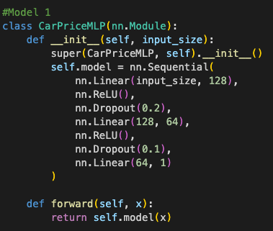
1000-Epochs Architecture
Input Layer → Linear(input_size, 128)
Activation → ReLU
Dropout → 20% (0.2)
Hidden Layer → Linear(128, 64)
Activation → ReLU
Dropout → 10% (0.1)
Output Layer → Linear(64, 1)

Slide 11
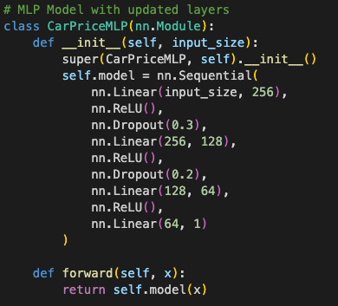
1000-Epochs Architecture w/ Early Stopping
Input Layer → Linear(input_size, 256)
Activation → ReLU
Dropout → 30% (0.3)
Hidden Layer 1 → Linear(256, 128)
Activation → ReLU
Dropout → 20% (0.2)
Hidden Layer 2 → Linear(128, 64)
Activation → ReLU
Output Layer → Linear(64, 1)

Slide 12
Optimization
Optimization in 1000 Epochs Model
Used the optimizer with default learning rate 0.001
Trained for full 1000 epochs with no early stopping
Used full-batch gradient descent (less efficient)
Added basic dropout (0.2, 0.1) to reduce overfitting
Simpler architecture: 128 → 64 with fewer parameters
Optimization in Early Stopping Epoch Model
Used the optimizer with a low learning rate of 0.0005
Enabled early stopping with patience = 50 to avoid overfitting
Trained with mini-batches (batch size = 64) for efficiency
Added dropout layers (0.3, 0.2) for regularization
Increased model depth (256 → 128 → 64) to better capture patterns

Slide 13
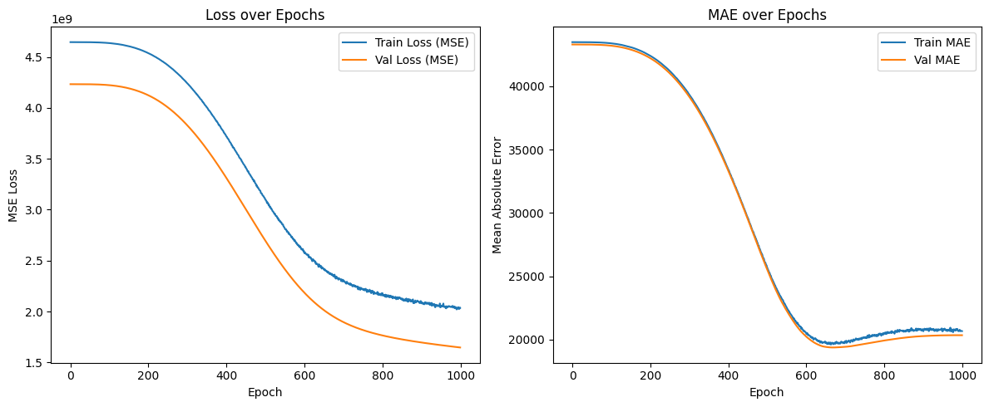
Loss/MAE with 1000 epochs
Learning Rate = 0.001, Epochs = 1000, Optimizer = Adam, Batch size = Full batch, Dropout Rate = 0.2, 0.1

Slide 14
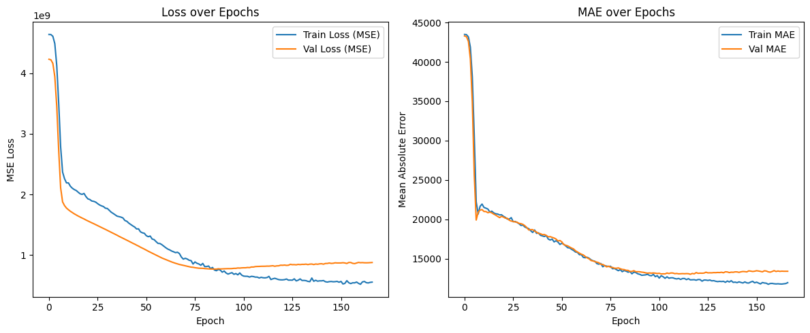
Loss/MAE with epoch stoppage
Learning Rate = 0.0005, Epochs = 150, Optimizer = Adam, Batch size = 64, Dropout Rate = 0.3, 0.2

Slide 15
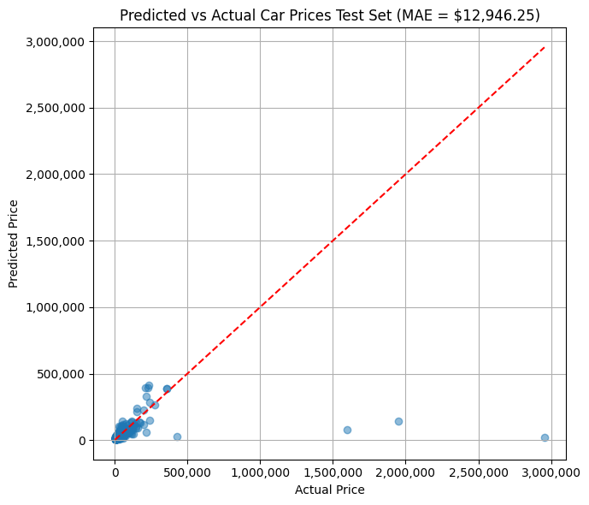
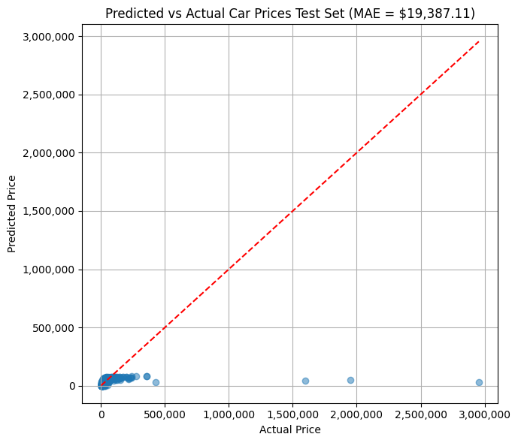
Results
Early Epoch Stop
1000 Epochs

Slide 16
Long Short-Term Memory
Speaker: Anthony Mingus

Slide 17
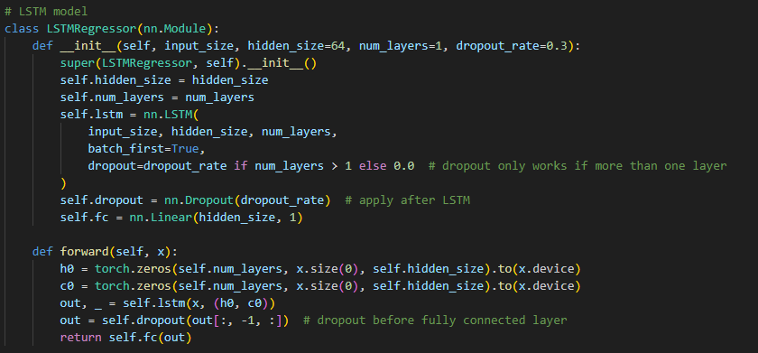
LSTM Architecture + Overview
A model known for learning long-term dependencies based on sequential data
Best used for language translation, speech recognition, video analysis etc.

Slide 18
Approach
Used a log transformation to avoid exploding gradients and large MSE (reversed after predictions for use in MAE and R^2)
Sequenced the features as a length of 1 since LSTM models rely on sequential data
Applied dropout to prevent neuron dependence, benefits from a smaller hidden-size due to the scarcity of parameters but requires multiple layers as dropout happens between layers
Hyperparameters:
hidden_size = 32 (smaller to avoid overfitting)
num_epochs = 1000
batch_size = 64
learning_rate = 0.001
dropout = 0.3

Slide 19
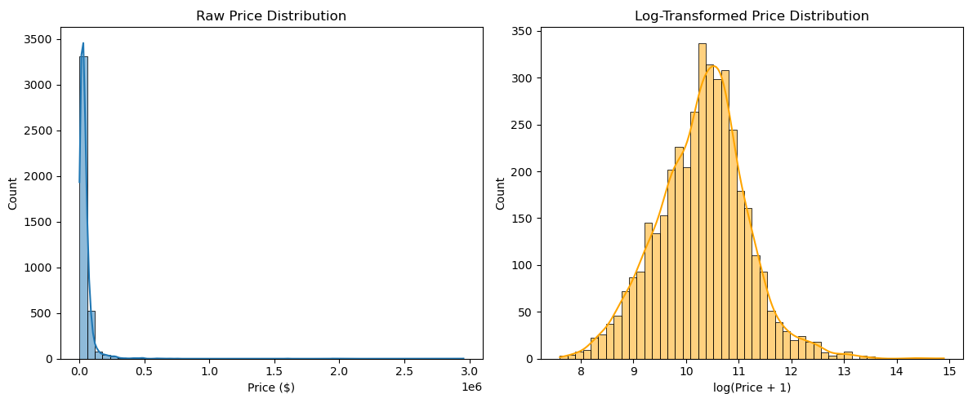
Log price transformation
Much of the data sits in the same price range, and as such is not easily differentiable
Log transformation makes the data more bell shaped and therefore easier to train on

Slide 20
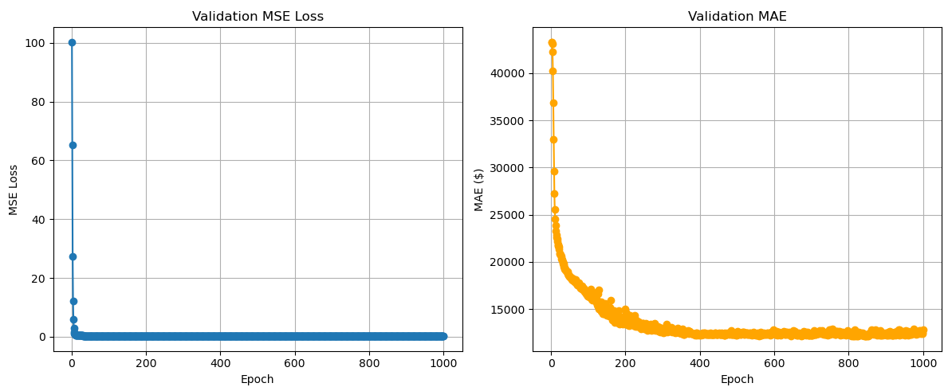
Loss Evaluation
MSE quickly settles, which seems to indicate the model learns the task quickly
MAE drops more curvilinearly, but settles somewhat high for what our model is trying to predict, settles around $12.7k

Slide 21
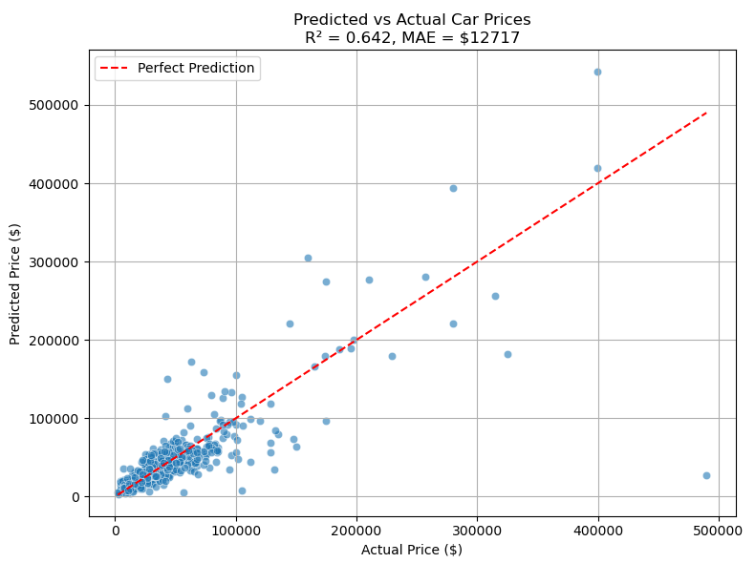
Results
From the graph, we can see it does not handle cars priced over $100,000 well, but seemingly is close with cars priced below $80,000 for various reasons
With a final evaluation of R^2 sitting around 0.64, the model is moderate at describing the relationship between the dependent and independent variables, but is off from the actual price by a fair margin in some cases.

Slide 22
TabNet
Speaker: William Widjaja

Slide 23
TabNet model
TabNet was proposed by the researchers at Google Cloud in the year 2019
The idea behind TabNet is to effectively apply deep neural networks on tabular data which still consists of a large portion of users and processed data across various applications such as healthcare, banking, retail, finance, marketing, etc.

Slide 24
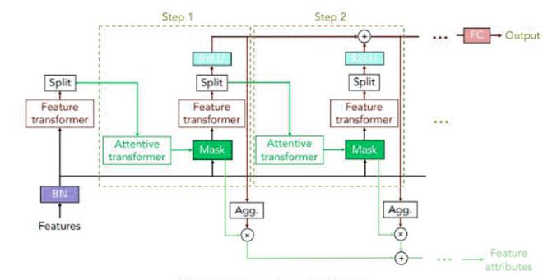
Architecture

Slide 25
Approach
Apply log transformation before training to avoid underfitting
y_train_log = np.log1p(y_train)
y_val_log = np.log1p(y_val)
y_test_log = np.log1p(y_test)
Model Parameter:
Max_epoch = 1000
Learning rate = 0.02
Batch size = 512
n_d/n_a = 32

Slide 26
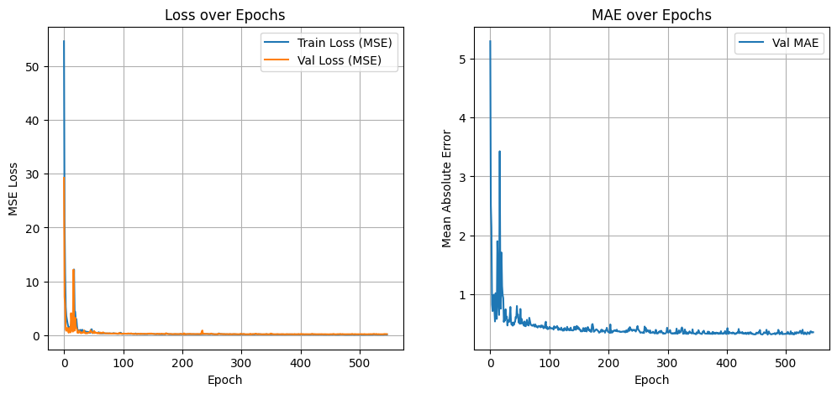
Loss evaluation
Final MSE value is nearing 0, which we can determine that the model fits the data well.
The models MAE keeps dropping by the end near 500 epochs

Slide 27
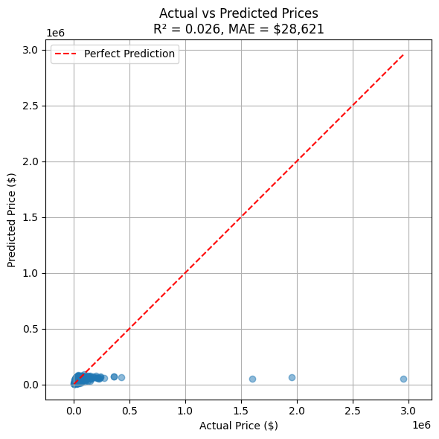
Results
R^2 = 0.026 means there are a 2.6% variance in the used car price
MAE = 28621, means on average the price prediction of this model is of by that much
This model also doesn’t do well with outliers.

Slide 28
Neural Factorization Model
Speaker: Fernando Malca

Slide 29
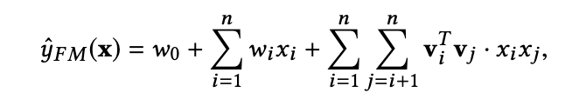
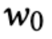
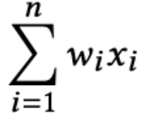
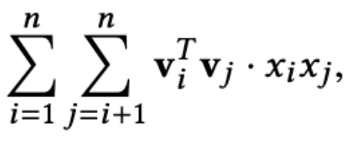
Factorization Machines:
: Global Bias (overall average price)
: Models each feature’s direct contribution
: Captures every pairwise interaction by the dot-product
Limitations:
All interactions remain linear
Real-world data is often highly non-linear and contains high-order patterns

Slide 30
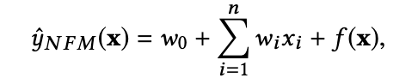
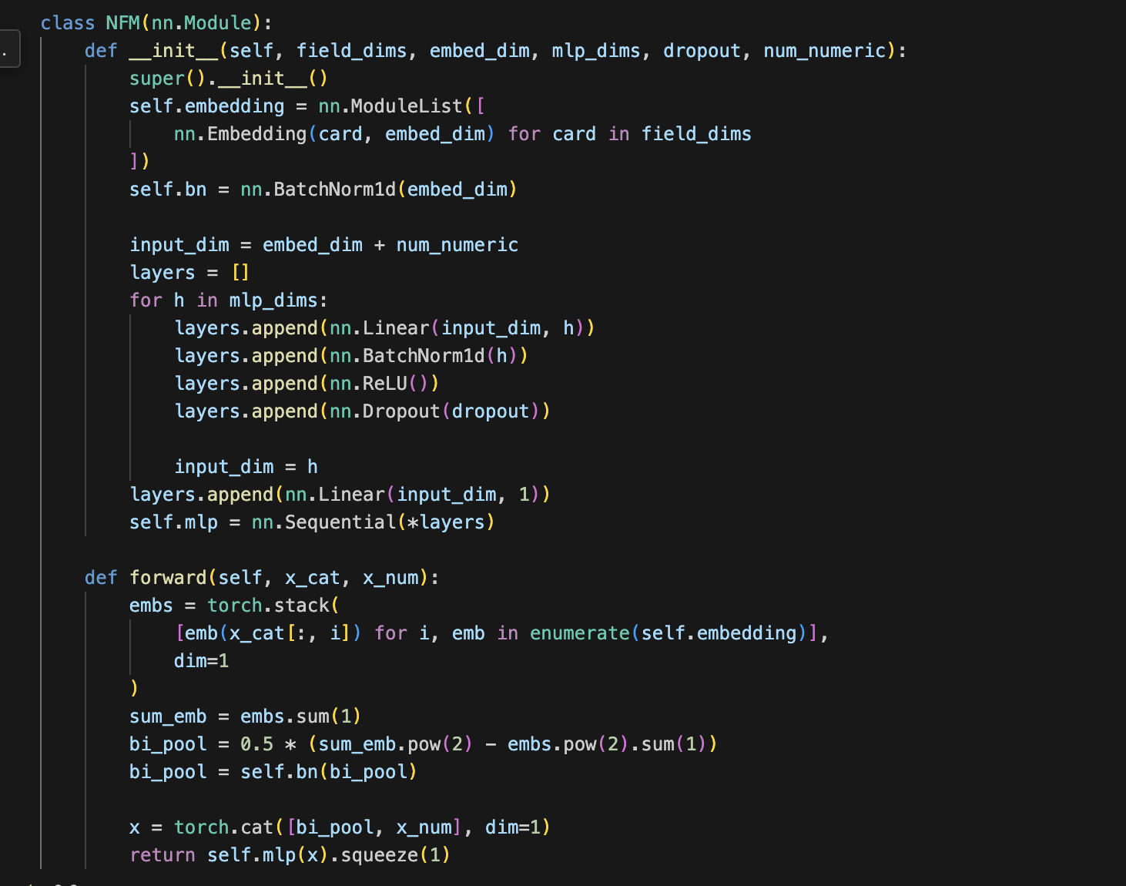
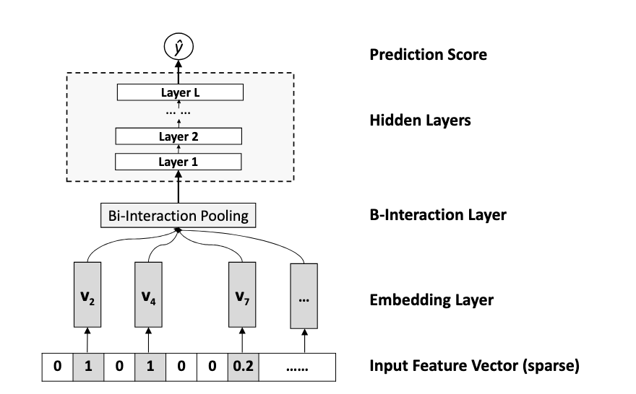
Neural Factorization Machine Architecture (NFM)

Slide 31
Approach (Hyperparameters)
Model Architecture:
Embedding Dimensions: 16
MLP Layers: [256, 128, 64]
Dropout: 0.2
Training Setup
Batch Size: 128 (mini-batches)
Epochs: 2000 w/ early stopping (patience of 150 epochs)
Optimizer: AdamW
Learning Rate: 0.001
Weight Decay: 0.001
LR-Schedule: Cosine Annealing Warm Restarts
T₀ 200 epochs
Using log-transformed price distribution like the one used in LSTM model
Leads to a smoother, more symmetric learning target
Integer-based encoding of the categorical fields

Slide 32
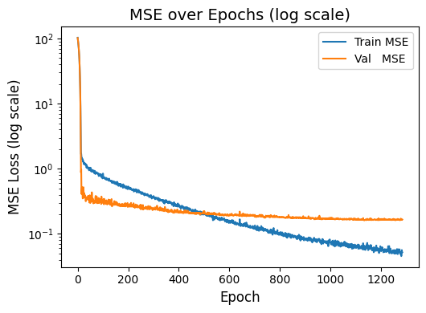
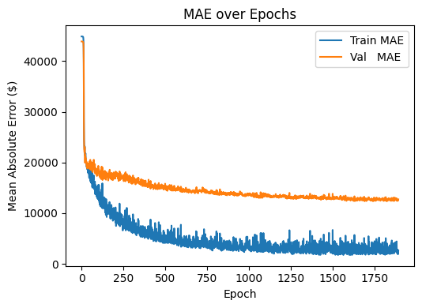
Loss Evaluation
Notes:
`1

Slide 33
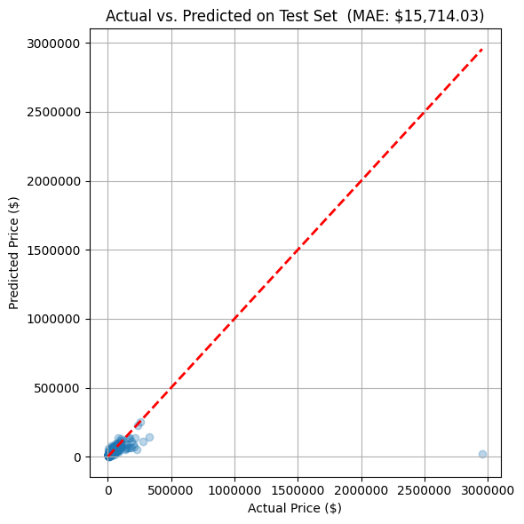
Results
When converted back into raw dollar terms Train MAE:
~$3,000 – $5,000
Validation MAE:
~$10,500–$14,000
Test MAE:
~14,000 - $16,000

Slide 34
Conclusion
MAE as the basis for comparison
LSTM model ended with the lowest MAE of $12.7k
Not entirely desirable, high margin of error
Speaker: Anthony Mingus

Slide 35
Things We Could Have Done Differently
LSTM not seeming to fit the problem at first
Bigger datasets with a wider range of values
Other model architectures:
DCN-V2
Wide&Deep
Random Forest
DeepFM
Focusing on a singular best model earlier
Speaker: Anthony Mingus

Slide 36
Works Cited
Paszke, A., Gross, S., Massa, F., Lerer, A., Bradbury, J., Chanan, G., ... & Chintala, S. (2019). PyTorch: An Imperative Style, High-Performance Deep Learning Library. Advances in Neural Information Processing Systems, 32.
Pedregosa, F., Varoquaux, G., Gramfort, A., Michel, V., Thirion, B., Grisel, O., ... & Duchesnay, É. (2011). Scikit-learn: Machine Learning in Python. Journal of Machine Learning Research, 12, 2825–2830.
Federal Trade Commission. (2024, December 19). FTC, Illinois Take Action Against Leader Automotive Group for Overcharging and Deceiving Consumers Through Add-Ons, Junk Fees, Bogus Reviews. Federal Trade Commission. https://www.ftc.gov/news-events/news/press-releases/2024/12/ftc-illinois-take-action-against-leader-automotive-group-overcharging-deceiving-consumers-through
He, X., & Chua, T.-S. (2017, August 16). Neural factorization machines for sparse predictive analytics. arXiv.org. https://arxiv.org/abs/1708.05027
Sharma, D. (2018, November 15). LSTM networks: A detailed explanation. Towards Data Science. https://towardsdatascience.com/lstm-networks-a-detailed-explanation-8fae6aefc7f9
Arik, Sercan, and Tomas Pfister. “TabNet: Attentive interpretable tabular learning.” Proceedings of the AAAI Conference on Artificial Intelligence, vol. 35, no. 8, 18 May 2021, pp. 6679–6687, https://doi.org/10.1609/aaai.v35i8.16826.

